Slide 2

Object Oriented Programming

Slide 3
Lexical Elements
Lexical elements in Java are the fundamental components of the code, such as keywords, identifiers, literals, operators, punctuation, and comments. They are the smallest meaningful units that the compiler recognizes and processes during the compilation of a Java program.

Slide 4
Lexical Elements contd..
Comments
within source code exist for the convenience of human programmers. They play no part in the generation of code and so are ignored during scanning. There are three kinds of comments:
// comment. Characters from // to the end of the line are ignored.
/* comment */ All characters between /* and the next */ are ignored.
/** comment*/ All characters between /** and the next */ are ignored.

Slide 5
Lexical Elements contd..
Identifiers
Identifiers, used for names of declared entities such as variables, constants, and labels, must start with a letter, followed by letters, digits, or both.

Slide 6
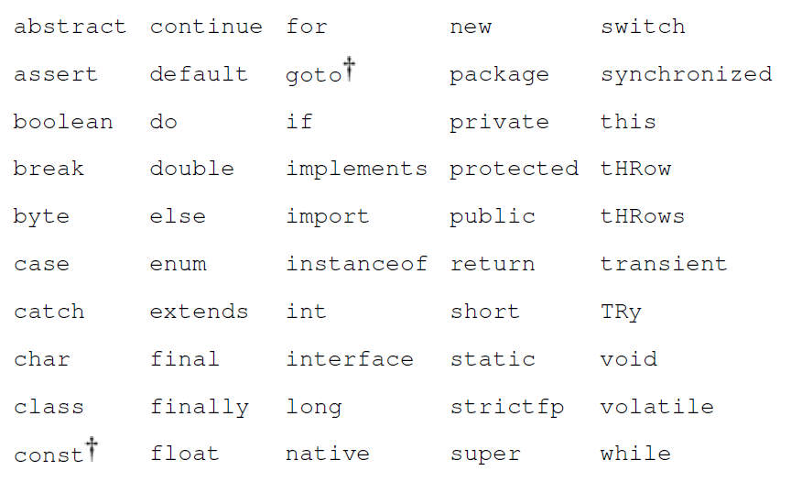
Lexical Elements contd..
Keywords: Language keywords cannot be used as identifiers because they have special meaning within the language. Keywords “goto” and “const” are reserved but currently unused. Although they appear to be keywords, null, true, and false are formally literals, just like the number 12, so they do not appear in the table.

Slide 7
Types and Literals contd..
The primitive data types are:
boolean either true or false
char 16-bit Unicode UTF-16 code unit (unsigned)
byte 8-bit signed two's-complement integer
short 16-bit signed two's-complement integer
int 32-bit signed two's-complement integer
long 64-bit signed two's-complement integer
float 32-bit IEEE 754 floating-point number
double 64-bit IEEE 754 floating-point number
Each primitive data type has a corresponding class type in the java.lang package. These wrapper classes Boolean, Character, Byte, Short, Integer, Long, Float, and Double also define useful constants and methods.

Slide 8
Types and Literals contd..
Boolean Literals
The boolean literals are true and false.
Character Literals
Character literals appear with single quotes: 'Q'. Any valid Unicode character can appear between the quotes. Certain special characters can be represented by an escape sequence:
\n newline
\t tab
\b backspace
\r return
\\ backslash itself
\' single quote
" double quote
*Literals means constants

Slide 9
Example – character literals
public class A {
public static void main(String[] args) {
char _char = '\n';
System.out.println("Good"+_char+"morning");
}
}
Good
morning
public class A {
public static void main(String[] args) {
char _char = '\r';
System.out.println("Morning"+_char+"Good");
}
}
Gooding
public class A {
public static void main(String[] args) {
char _char = '\b';
System.out.println("Good"+_char+"Morning");
}
}
GooMorning

Slide 10
Types and Literals contd..
Integer Literals
Integer constants are strings of octal, decimal, or hexadecimal digits. The start of a constant declares the number's base: A 0 (zero) starts an octal number (base 8); a 0x or 0X starts a hexadecimal number (base 16); and any other digit starts a decimal number (base 10). All the following numbers have the same value:
29 035 0x1D 0X1d
Integer constants are long if they end in L or l, such as 29L;
If an int literal is directly assigned to a short, and its value is within the valid range for a short, the integer literal is treated as if it were a short literal.
Floating-Point Literals
Floating-point constants are expressed in either decimal or hexadecimal form. The decimal form consists of a string of decimal digits with an optional decimal point, optionally followed by an exponent the letter e or E, followed by an optionally signed integer. At least one digit must be present. All these literals denote the same floating-point number:
18. 1.8e1 .18E+2 180.0e-1

Slide 11
Types and Literals contd..
The hexadecimal form consists of 0x (or 0X), a string of hexadecimal digits with an optional hexadecimal point, followed by a mandatory binary exponent the letter p or P, followed by an optionally signed integer. The binary exponent represents scaling by two raised to a power. All these literals also denote the same floating-point number (decimal 18.0):
0x12p0 = 0x12(18) * 2^0 = 18.0
0x1.2p4 = 0x1.2 * 2^4 = 1.125 * 2^4 = 18.0
0x.12P+8 = 0x12 * 2^-4 = 18 * 2^-4 = 1.125
0x120p-4 = 0x120 * 2^-4 = 288 * 2^-4 = 18.0
Floating-point constants are of type double unless they are specified with a trailing f or F, which makes them float constants, such as 18.0f. A trailing d or D specifies a double constant.

Slide 12
String Literals
String literals appear with double quotes: "along". Any character can be included in string literals, except for newline and " (double quote).
Newlines are not allowed in the middle of strings. If you want to embed a newline character in the string, use the escape sequence \n. To embed a double quote use the escape sequence \".
A string literal references an object of type String.

Slide 13
Variables
A variable is a storage location something that can hold a value to which a value can be assigned. A variable declaration states the identifier (name), type, and other attributes of a variable.
Field and Local Variable Declarations
A declaration is broken into three parts: modifiers, followed by a type, followed by a list of identifiers.
float x, y; is the same as
float x;
float y;
float x = 3.14f, y = 2.81f; is same as float x = 3.14f,
y = 2.81f;

Slide 14
Variables contd..
Field variables are members of classes, or interfaces, and are declared within the body of that class or interface. Fields have a lifetime that is tied to the lifetime of the object (instance) of the class they belong to. They exist as long as the object they are a part of is in memory.
Local variables Local variables, on the other hand, are declared within methods and have a limited scope. They can only be accessed within the method in which they are declared
Parameter Variables are the parameters declared in methods, constructors, or catch block. A parameter declaration consists of an optional modifier, a type name, and an identifier.

Slide 15
Variables contd..
final Variables Final modifier declares that the value of the variable is set exactly once and will thereafter always have the same value. Any variable fields, local variables, or parameters can be declared final. Variables that are final must be initialized before they are used.

Slide 16
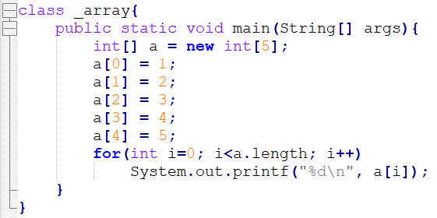
Array Variables
An array is a data structure that allows you to store a fixed-size collection of elements of the same data type. Arrays provide a way to group related data under a single variable name. Each element in an array can be accessed using an index, which indicates its position in the array.
type[] name = new type[length];
Output
1
2
3
4
5

Slide 17
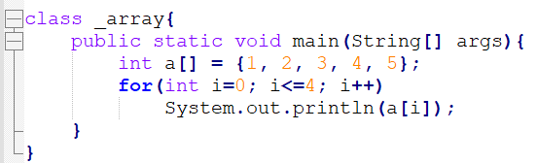
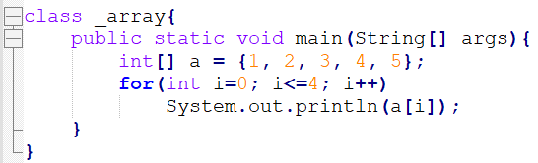
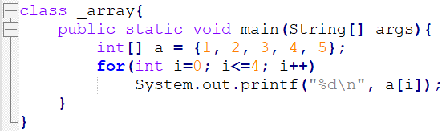
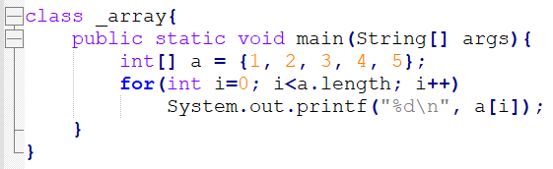
Output
1
2
3
4
5

Slide 18
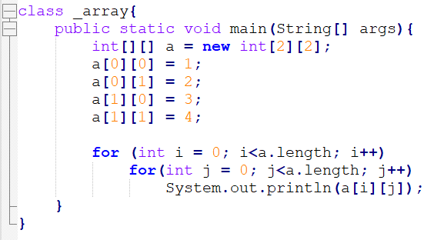
Arrays of Arrays
You can have arrays of arrays.
Output
1
2
3
4
5

Slide 19
Array Initialization
When an array is created, each element is set to the default initial value for its type, zero for the numeric types, '\u0000' for char, false for boolean, and null for reference types.
String[] dangers = { "Lions", "Tigers", "Bears" };
The following code gives the same result:
String[] dangers = new String[3];
dangers[0] = "Lions";
dangers[1] = "Tigers";
dangers[2] = "Bears";
When you initialize an array within its declaration, you don't have to explicitly create the array using new, it is done implicitly for you by the system.
The length of the array to create is determined by the number of initialization values given.
You can use new explicitly if you prefer, but in that case you have to omit the array length, because again it is determined from the initializer list.
String[] dangers = new String[]{"Lions", "Tigers", "Bears"};

Slide 20
The Meaning of Names
Identifiers give names to a range of things within programs types, variables, fields, methods, and so forth.
When you use a particular name in your program, the compiler has to determine what that name refers to, so that it can decide if you are using the name correctly and so that it can generate the appropriate code.
Name management is achieved with two mechanisms. First, the namespace is partitioned to give different namespaces for different kinds of names. Second, scoping is used to control the visibility of names declared in one part of a program to other parts.
There are six different namespaces:
· package names,
· type names,
· field names,
· method names,
· local variable names (including parameters), and
· labels

Slide 21
The Meaning of Names
The use of separate namespaces gives you greater flexibility when writing code (especially when combining code from different sources) but can be abused. Consider this pathological, but perfectly valid, piece of code:
package Reuse;
class Reuse {
Reuse Reuse(Reuse Reuse) {
Reuse:
for (;;) {
if (Reuse.Reuse(Reuse) == Reuse)
break Reuse;
}
return Reuse;
}
}

Slide 22
References
Gosling, J., Holmes, D. C., & Arnold, K. (2005). The Java programming language.

